Slide 1
Established in 2009
Your UMKC Foundation November 2017
The first 8 years, and beyond

Slide 2
Mission & Vision
Mission – Foster a culture that inspires philanthropy to achieve university priorities.
Vision – To be the valued and trusted partner that inspires, enlists and unites philanthropic support for Kansas City’s premier urban university.

Slide 3
Foundation’s Formation
Time to Get it Right Study – Benno Schmidt
- Section VIII – UMKC – A strategy for a First-Rate Urban University
Phase 1 – Governance and Leadership
- Formation of a Foundation
Phase 2 – Academic Strategies
UM System Approved
- Only campus with fundraising responsibilities outsourced to a Foundation

Slide 4
WHY?
5 Main Sources of Revenue for UMKC
State of Missouri support
Tuition and fees
Auxiliaries
Grants and Contracts
Philanthropy

Slide 5
Other reasons for a Foundation
Helpful during Chancellor transition
Resistant to state and system funding challenges, therefore less interruption to fundraising efforts
Long term anchors/continuity with community
Help ensure key strategic initiatives remain strong
Investment flexibility
Legally independent for a number of good reasons, but not independent in our goals
Board diversity – broad industry expertise vs. governor appointed

Slide 6
Board of Directors
Terry Dunn Construction
Tom Bloch Education
Kent Sunderland Manufacturing/Foundation
John Sherman Energy/Foundation
Betsey Solberg Public Relations
Barbara Bichelmeyer Education
Warren Erdman Railway Administration
Gary Forsee Telecommunications/Education
Tom Hyde Legal
Nikki Krawitz Finance/Education
Jerry Reece Real Estate
Bob Regnier Banking
Josh Sosland Publishing
Nelson Sabates Optometry
Joel Voran Legal
UMKC Foundation board members lifetime giving to UMKC is about $53 million.
6 out of top 10 living donors to UMKC are members of the Foundation Board

Slide 7
Why do people give to UMKC?
Believe every great city needs a great university.
UMKC provides a service to area corporations and non-profits.
UMKC priorities align with donor’s interests and passions.
Alumni are appreciative for their education and university experience and want to give back.

Slide 8
The Campaign for UMKC This is the time, This is the Place
July 1, 2009 – June 30, 2016
Goal of $250 million
Raised $300 million
Type of Gift | Amount Raised during Campaign
Facilities | $103,599,289
Faculty/Staff Support | $17,389,253
Scholarships | $58,172,437
Programs | $103,298,938
Unrestricted | $11,743,508
Sponsored Research | $5,865,167
Total | $300,068,593

Slide 9
Predictive Giving results
Prospects are segmented into action groups based on how likely they are to make a gift, as well as their individual capacity:
Best Prospects (Green) – Highest attention; target for acquisition or repeat gifts at specific amounts
Second Tier (Yellow-Orange) – Solicit as budget & time allows; acquisition effort should also be conducted
Lower Scoring (Red) - Consider reducing investment in these individuals unless special circumstances apply
 | $1 - $250 | $251-$1,000 | $1,001-$5,000 | $5,001-$10,000 | $10,001-$25,000 | $25,001-$50,000 | $50,001+
Good to Excellent Likelihood | 11,900 | 8,950 | 10,284 | 2,652 | 557 | 237 | 131
Average Likelihood | 623 | 335 | 307 | 37 | 51 | 20 | 14
Low-Scoring Likelihood | 138,279 | 9,802 | 4,293 | 263 | 43 | 12 | 8

Slide 10
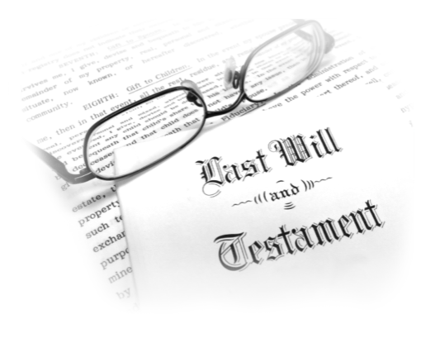
Planned Giving Results
The record count below represent the best planned giving prospects for your organization
Demographic information on this chart provides a generational aide as you consider what will be your most effective marketing tools based on your chosen segmentation
Planned Giving Likelihood Score | All Ages | Greatest: 1901-1924 | Silent: 1925-1945 | Baby Boomer: 1946-1964 | X: 1965-1981
Good to Excellent Likelihood | 18,727 | 594 | 6,788 | 7,413 | 2,068

Slide 11
ORGANIZATIONAL STRUCTURE WITH NAMES
Board of Directors
UMKC Foundation
Katherine Walter Executive Assistant
Steven Norris - President
UMKC Foundation
UMKC Research Foundation
- - - - - - - - - - - - - - - - -
- - - - - - - - - - - - - - - - - - - - - - - - - - - - - - - - - - - - - - - - - - - - - - - - - - - - - - -
Jay Wilson Assistant Vice President
Jeff Chapman Assistant Vice President
Jennifer Ingraham Assistant Vice President
School of Biological Sciences
Ashley Beard-Fosnow Henry W. Bloch School of Management
Jason Elliott College of Arts and Sciences
Michelle Brownlee Director of
Prospect Research
Hilary Wheat School of Dentistry
Kirk Baughan School of Law
Elizabeth Wheeler School of Computing and Engineering
Jennifer Ezelle Prospect Research Assistant
Graduate Studies
School of Medicine
Honors College
Mark Mattison Conservatory of Music and Dance
Jean Peat Director of
Stewardship & Donor Communications
School of Nursing and Health Studies
Planned Giving
Shelly Doucet School of Education
Patricia O’Dell Communication Coordinator
Corporate Relations
School of Pharmacy
Library
Emily Wurtz Director of Annual Giving
Shannan Henderson Donor Relations Specialist
Diversity & Inclusion
Logan Cheney Call Center Manager
- - - - - - - - - - - - - - - - - - - - - - - - - - - - - - - - - - -
Foundation Relations & OR Liaison
- -
- -
- -
Danny Baker & David Fulk KCUR
Kansas City Repertory Theatre
Mike Magnusson Athletics
Updated 2017-10-06

Slide 12
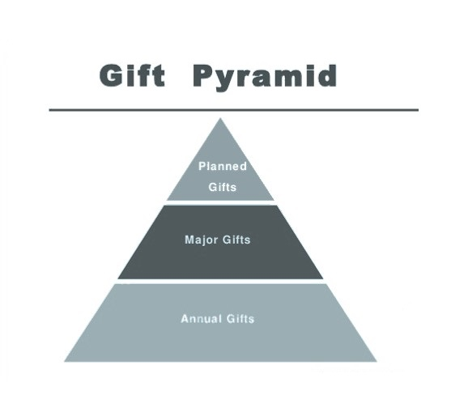
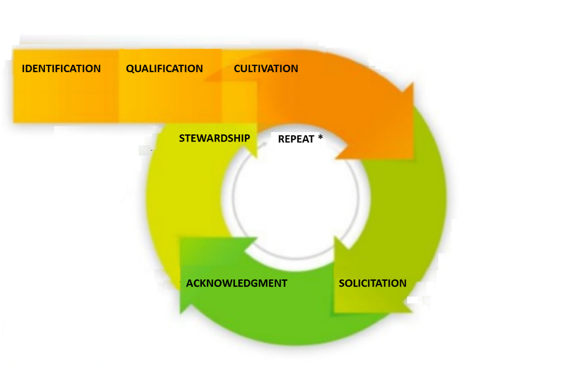
Development 101

Slide 13
How Faculty can support the UMKC Foundation
1) Create a compelling vision 2) Work with deans and school leadership in the priority-setting process
3) Articulate the case for support
4) Collaborate with professional development staff
5) Identify and facilitate partnerships with alumni, corporate partners, and benefactors
6) Maintain relationships for the long term
7) Thank and recognize donors

Slide 14
How the UMKC Foundation supports Faculty
Raise money for the institutional priorities
Manage endowments for the benefit of UMKC

Slide 15
Campaign to 2033
Pre-campaign work
- Predictive giving study ☑
- Advancement review and campaign readiness study ☑
- October 2017 thru June 2018
Position foundation and university for silent launch of campaign
Phase 1 - Health Sciences & Research
July 2018 – June 2025
* 11,000 Alumni in Medicine and Dentistry
* Facilities in need of major renovation, or replacement
* TBD
Phase 2 - TBD
July 2025 – June 2033

